Slide 1
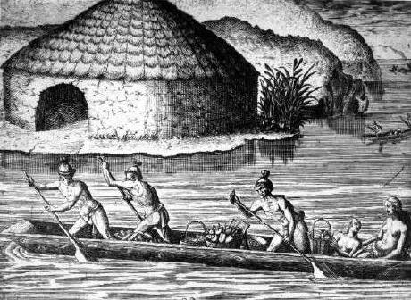
The Timucua Tribe of the Southeast Woodlands

Slide 2
What are we learning?
Essential Question
Who are the Timucuas, where are they from, and what did they do?

Slide 3
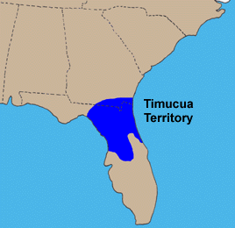
Where did the Timucuas live?
The Timucuas lived in the Southeastern Woodlands of North America in what we now call Florida.
There were at least 20 Timucua villages in what is now Jacksonville.
Notes:
Where is Jacksonville on this map of Florida? Where did the Calusa, Apalachee, Tequesta, and Tocobaga live?

Slide 4
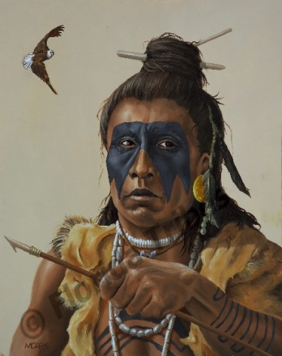
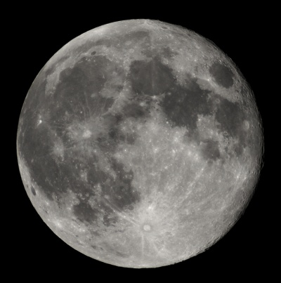
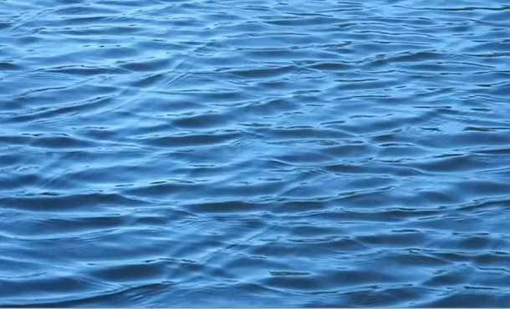
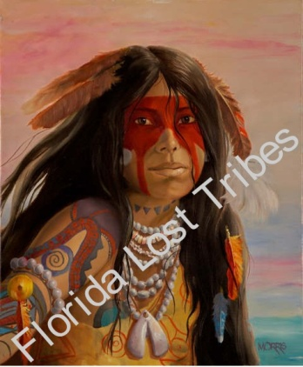
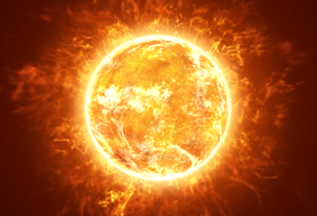
What language did the Timucuas speak?
The Timucuas spoke a language that we now call Timucua Language.
Ibi
Acu
Biro
One – Yaha
Two – Yucha
Three – Hapu
Four – Cheqeta
Five - Marua
Nia
Ela

Slide 5
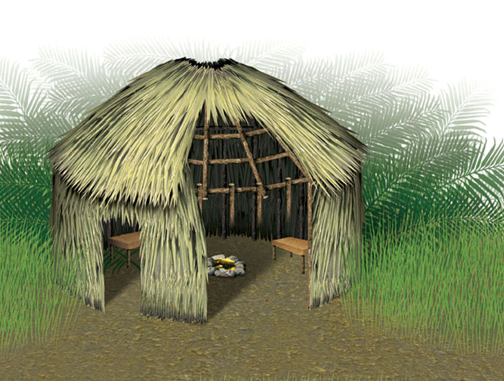
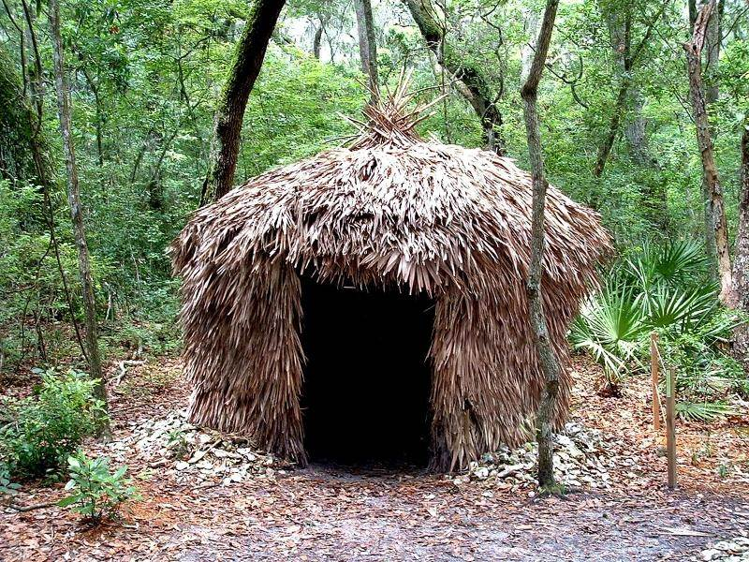
What kind of house did the Timucuas live in?
The Timucuas lived in round huts made from tree trunks driven into the ground and tied together. Then, they were topped with palm fronds that had been woven together to make a strong, waterproof covering. There was a small door on one side and a smoke hole in the roof.
Notes:
What do we call drawings that show the parts of something? [diagram]
What was the name of the Calusa huts? How are the huts similar/dissimilar?

Slide 6
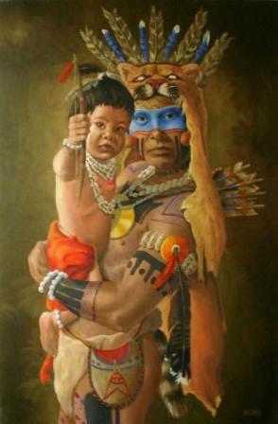
What kinds of clothes did the Timucua people wear?
Men wore loin cloths made from animal skins.
Women wore sashes and belts made out of Spanish moss.
They also wore moccasins on their feet.
Notes:
Like the Spanish moss, we make our clothes from plants too: What is this plant?
The Timucuas used animal skins to make their clothes. Some people wear leather now. What animal does this come from?

Slide 7
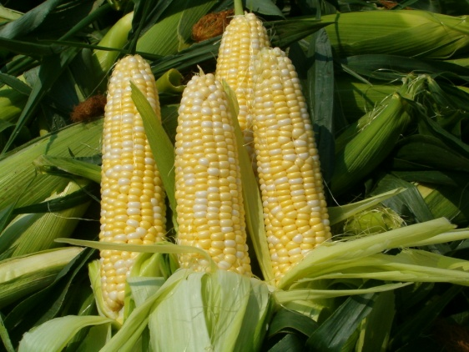
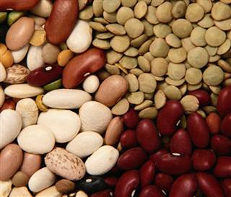
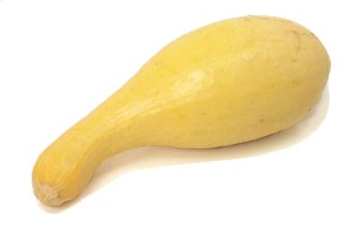
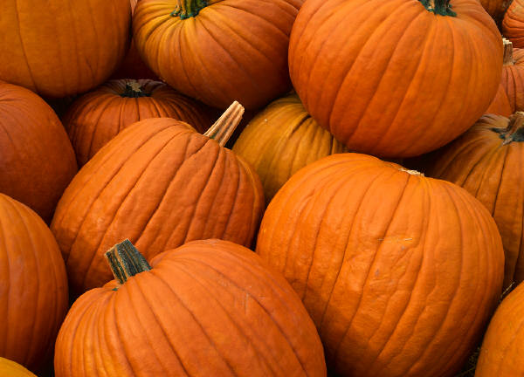
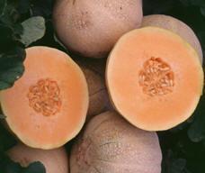
What did the Timucuas farm?
Corn / Maíz
Beans / Frijoles
Squash / Chayote
Pumpkins / Calabazas
Melons / Melones
Notes:
How is this like or unlike the food the Tocobago, Tequesta, Calusa, and Apalachee ate?

Slide 8
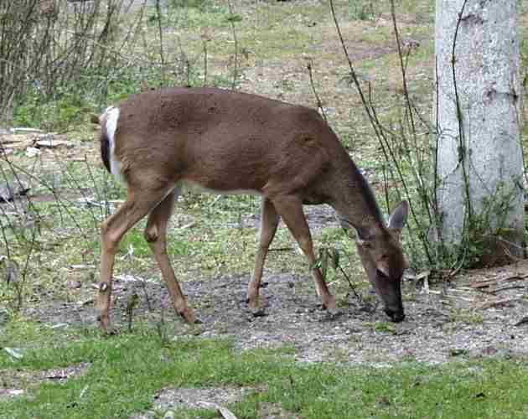
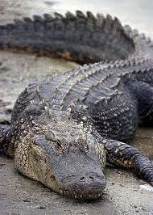
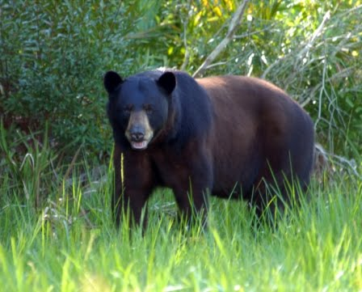
What did the Timucuas hunt?
Alligator / Caimán
The Timucuas cooked their meat by boiling it over an open fire called a barbacoa. Fish and other meats were dried out to make jerky.
Deer / Ciervo
Bear / Oso
Turkey / Pavo
Notes:
How is this similar to the animals the other tribes hunted?

Slide 9
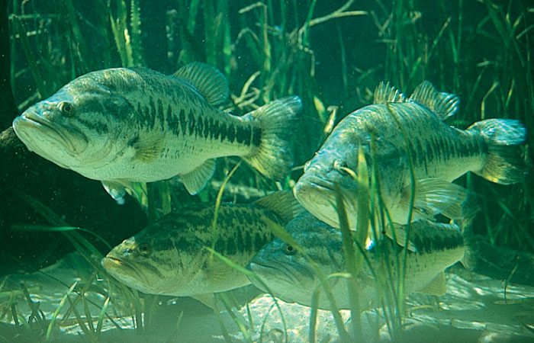
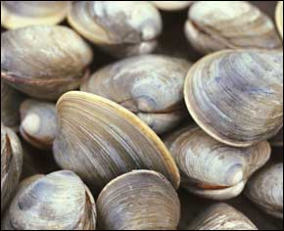
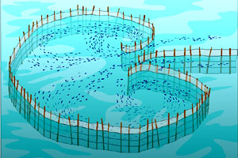
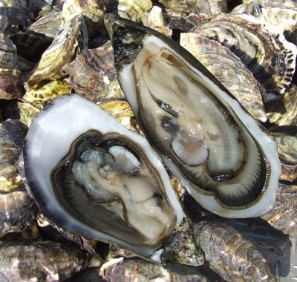
How did the Timucuas use the water for food?
The Timucuas used a fishing trap, like a wood fence in the stream, called a ‘weir’.
Clams / Almejas
Fish / Pescado
Oysters / Ostra
Weir / Presa
Notes:
How is this dissimilar to the other tribes we have studied? Why?

Slide 10
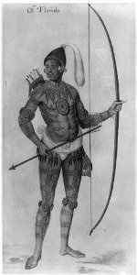
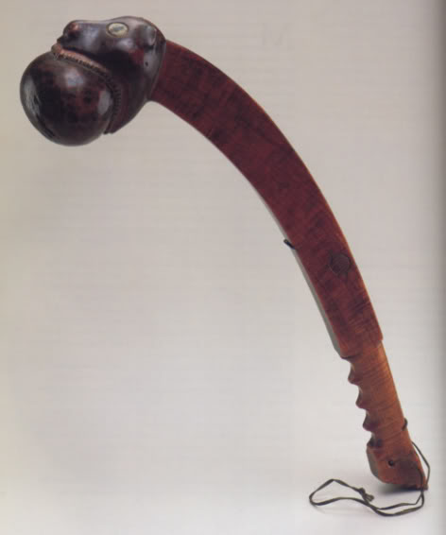
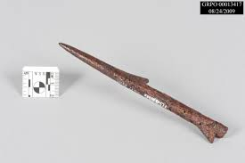
What tools did the Timucuas use?
The Timucuas used spears, clubs, and bows and arrows.
Notes:
What other tools can you use to hunt?

Slide 11
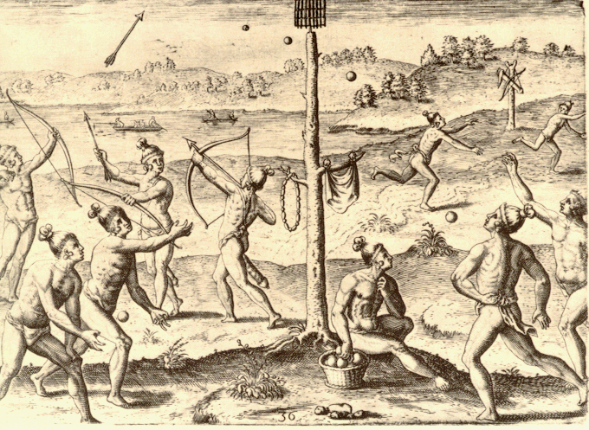
What activities did the Timucuas participate in?
The Timucuas played ball games called “Apalachee Ball Game” and “Chunkey”.
They also liked to run, dance, and shoot their bows and arrows (archery).

Slide 12
Interesting Facts About the Timucua
The last Timucua Native American died in 1767. They are one of only a few Native American tribes that have gone completely extinct.
Warriors wore shell jewelry to make noise as they approached their enemies.
They used animal bones to make needles, ear pins, whistles, flutes, knives, axes, and fishhooks.
Notes:
What does ‘extinct’ mean?
Why would the language go extinct when the last Timucua died?

Slide 13
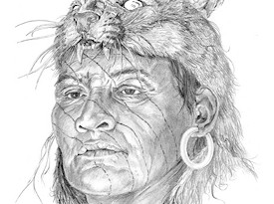
Interesting Facts Continued
Men and women decorated their skin with tattoos and paint and wore long hair with feathers, sticks, bones, leaves, and raccoon tails.
Hunters dressed as the animal they were hunting.

Slide 14
Resources
Google Images
Children’s Museum - http://www.explorecmsj.org/files/18b53a4f-7ac2-46e0-a1ac-22ea20c696b3.pdf
Wikipedia - http://en.wikipedia.org/wiki/Timucua#Settlements
University of South Florida - http://fcit.usf.edu/florida/lessons/timucua/timucua1.htm
Jackonsville Historical Society - http://www.jaxhistory.com/Jacksonville%20Story/Timucua%20Times.htm
Native Languages - http://www.native-languages.org/timucua.htm

